Slide 1
Tutorial 05: Anti-patterns and refactoring
SOEN 343 Tutorials
2020 Fall

Slide 2
Instructions
Individually answering the following refactoring exercise
The outcome of your work has to be uploaded to Moodle web site to the corresponding slot (tutorial 4 assignment)
The format is a pdf file
Note that the slot for submitting the tutorial assignment is open until the end of the week (Sunday 23:59 EST time)

Slide 3
Description of the problem (1/3)
Refactoring is a software maintenance activity that aims to improve code design, while preserving behavior.
Anti-patterns are poor design choices to recurring design problems, and they are opposite to design patterns. Typically, they are introduced by inexperienced developers, and represent common pitfalls in software development.
Your objective is to remove one anti-pattern instance previously identified in an Open-source systems developed using Java..
You could use any of the refactorings proposed by the catalog of Martin Fowler (https://refactoring.com/catalog/

Slide 4
Description of the problem (2/3)
The purpose of this tutorial is to perform refactoring of anti-patterns in the wild.
Target system: Xbus Version:
Anti-pattern type: Blob
Instructions:
1. Clone the repository of the project containing the anti-pattern
git clone https://moar82@bitbucket.org/moar82/83.git
2. Open Eclipse IDE
3. Import the project in the workspace (see screenshots at the end)
4. Refactor the anti-pattern
Class containing anti-pattern:
net.sf.xbus.technical.mail.POP3XMLReceiver

Slide 5
Description of the problem (3/3)
5. It is very important that you validate that your code compiles after applying the refactoring(s) required to remove the anti-pattern.
Once you are satisfied with your code, you can check the classes that you modified from the command line, in the folder where you clone the repo, by typing on git command line:
git status
NOTE: if you need to clean the repo, to discard your current changes, you can use the following commands:
git fetch --all
git reset --hard
6. Add all the changes related to java classes that you modify after refactored the anti-pattern
git add *.java
7. Generate the patch with your changes
git diff --cached > mm_83_1_POP3XMLReceiver_YOUR_STUDENT_ID.patch
Where YOUR_STUDENT_ID is equal to your Concordia’s student id
Remember to test your patch against your repository, by discarding your changes, and applying it using git apply command
8. submit the generated patch through Moodle
It is the responsibility of the student to make sure that the patch is correctly saved and can be applied to any clone of the repository in question.

Slide 6
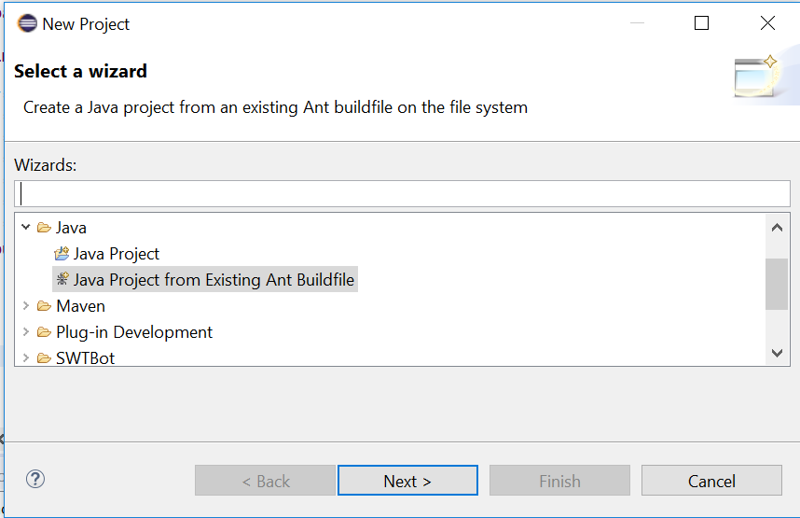
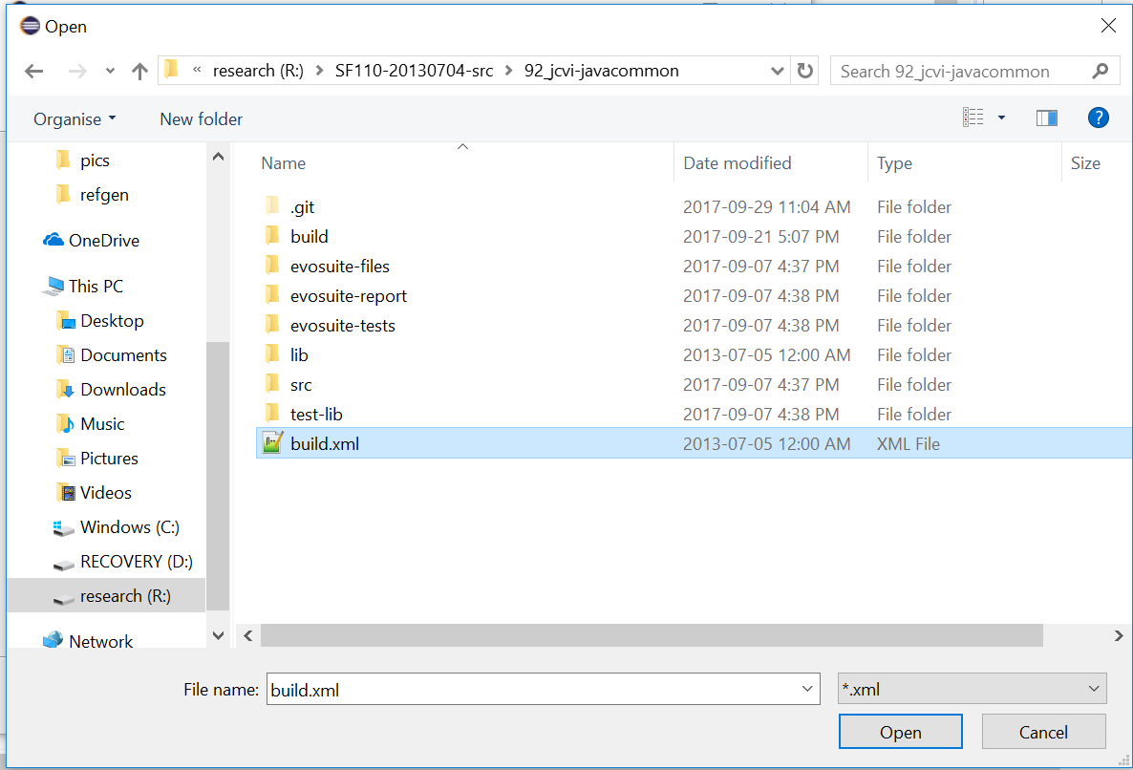
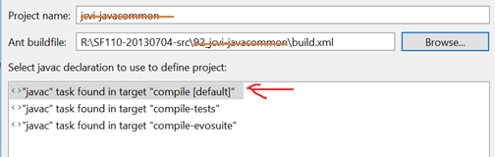
Import ant project in eclipse

